Slide 1
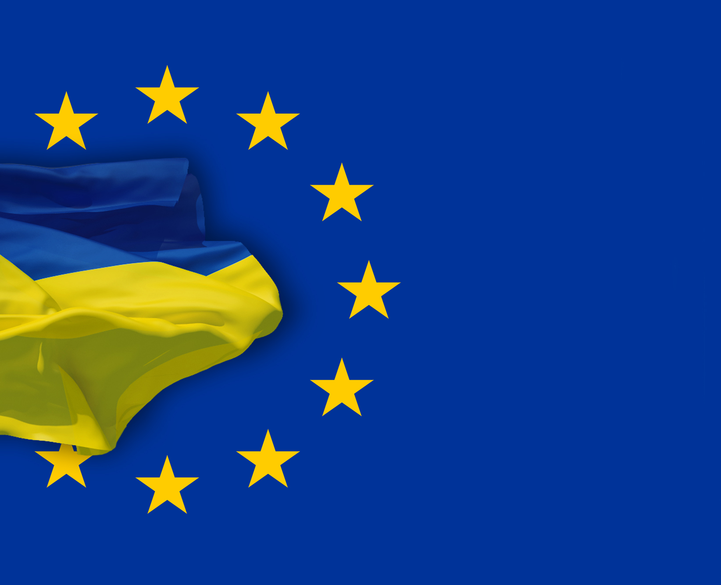
Head of the State Regulatory Administration of Ukraine
Ksenia Lyapina
14th Sitting of the OECD Regulatory Policy Committee
April 2016

Slide 2

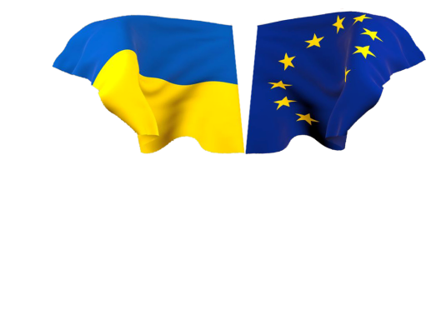
Ksenia Lyapina – Head of the State Regulatory Administration of Ukraine
Participants of the Regulatory Process
Regulatory bodies
Designated authorities
President of Ukraine
Verkhovna Rada
of Ukraine
Cabinet of Ministers
of Ukraine
Central executive
authorities
Local authorities
NGOs
State
Regulatory
Administration
of Ukraine
Economic entities
Associations of
economic entities
Research institutions
Consulting and advisory
agencies
Citizens
Together towards development of a high quality regulatory act

Slide 3
Ksenia Lyapina – Head of the State Regulatory Administration of Ukraine
Principles of the State Regulatory Policy
Fundamental principles
of the state regulatory
policy
in decision-making
Feasibility
Transparency
Efficiency
Predictability
Adequacy
Balance
Consideration of public opinion
The Law on Regulatory Policy in Ukraine was adopted in 2004 based on the best European experience

Slide 4
Ksenia Lyapina – Head of the State Regulatory Administration of Ukraine
Regulatory Act Development and
Preparation of the RIA
Preparing a
draft regulatory
act
Discussing a
draft regulatory
act
Regulatory authorities
Public
Problem identification
Conducting RIA and SME-test
Developing a draft regulatory act
Publication of the draft and RIA
Mandatory review of
proposals and comments
from the public
Public discussions and
public hearings
Drafting proposals and
remarks regarding RIA
Approval
SRSU
Monitoring compliance
with the procedures, examination
of the regulatory act and
checking for RIA adequacy
Adoption and promulgation

Slide 5
Ksenia Lyapina – Head of the State Regulatory Administration of Ukraine
Regulatory Impact Analysis (RIA)
necessity of the state regulation
RIA - informative
and analytical document
which substantiates:
compliance with the principles
of the state regulatory policy
achieving best possible
positive results with minimum costs
Since 2016 – conducting of SMЕ-test
RIA is an integral part of every draft regulatory act

Slide 6
Ksenia Lyapina – Head of the State Regulatory Administration of Ukraine
п
Conducting of SMЕ-test
Conducting consultations with business
Calculating
costs
Processing data for
SMЕ-test
Reducing the cost of regulation for business
Developing mitigating measures

Slide 7








Ksenia Lyapina – Head of the State Regulatory Administration of Ukraine
Deregulation
Permits and
licensing
Agriculture
Food
industry
Technical
regulation
Construction
€0,8 –1,2 billion
ACTION
PLAN on
deregulation
of economic
activity
State
supervision
Electric
Power industry
Taxes
and duties
Oil
industry
«Doing
Business»
rating
Tele-
communications
IT sector
It is planned to use in future
«one in – two out» principle

Slide 8




Ksenia Lyapina – Head of the State Regulatory Administration of Ukraine
Official web-site
www.drs.gov.ua
іnform@dkrp.gov.ua
Tel. +38(044) 285-05-55
Facsimile 254-43-93
Address:
9/11 Arsenalna Str.
01011, Kyiv, Ukraine
www.kmu.gov.ua
+38(044) 284-19-15

